Slide 1
Day 2

Slide 2
Agenda
Scroll View
Image View
Radio Group
Radio Button
Checkbox
Activity
Intent
24/05/2021
Basic Java
2

Slide 3
Scroll View

Slide 4
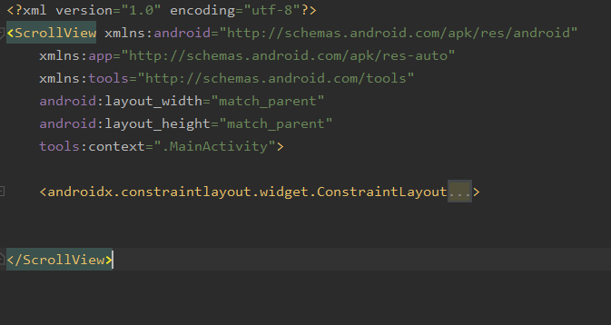
Scroll View
A view group that allows the view hierarchy placed within it to be scrolled.
Scroll view can have only one direct child placed within it.
To add multiple views within the scroll view, make the direct child you add a view group, for example Constraint Layout, and place additional views within that Constraint Layout.

Slide 5
Image View

Slide 6
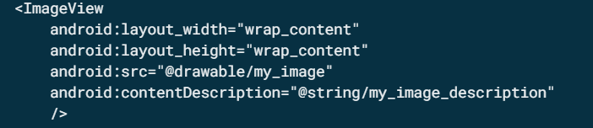
Image View
Image View is also commonly used to apply tints to an image and handle image scaling.

Slide 7
Radio Group

Slide 8
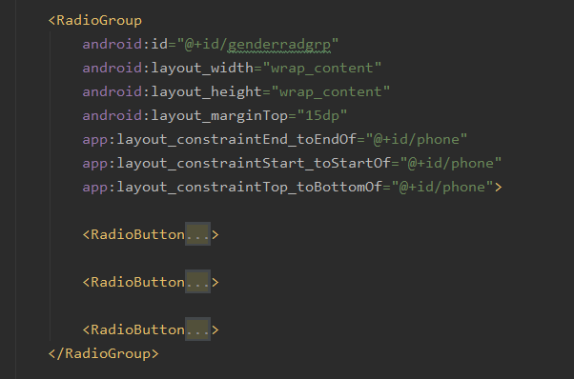
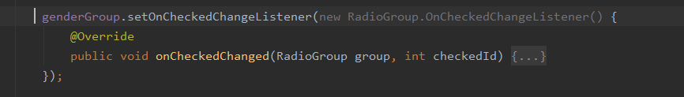
Radio Group
This class is used to create a multiple-exclusion scope for a set of radio buttons
Checking one radio button that belongs to a radio group unchecks any previously checked radio button within the same group.
We will use a listener to listen the input from set of radiobuttons from user using RadioGroup.OnCheckedChangeListener.

Slide 9
Radio Button

Slide 10
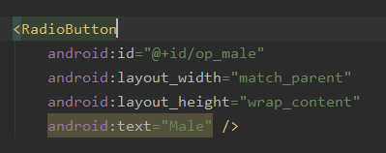
Radio Button
A radio button is a two-states button that can be either checked or unchecked.
However, contrary to a Checkbox, a radio button cannot be unchecked by the user once checked.
All radio buttons should be inside a Radio Group.

Slide 11
Checkbox

Slide 12
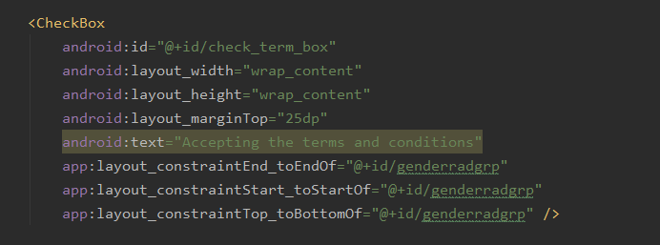
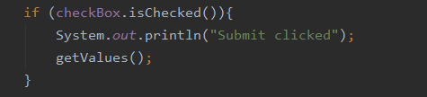
Checkbox
Checkboxes allow the user to select one or more options from a set.
Main EditText Functions:
isChecked() : To retrieve Text from the widget.
setChecked(Boolean b): To set a boolean to show whether checked or not.

Slide 13
Activity

Slide 14
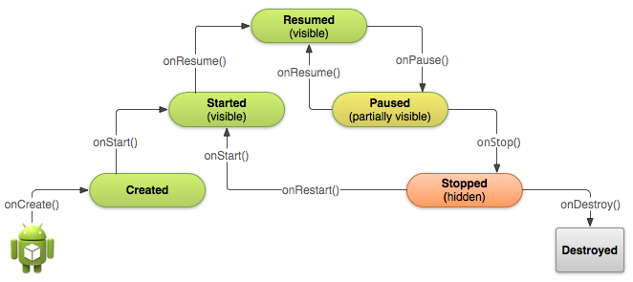
Activity
An Activity is an application component that provides a screen with which users can interact in order to do something.
Activity class must be extended to its parent class AppCompatActivity.
The Diagram shows how activity lifecycle works

Slide 15
Intent

Slide 16
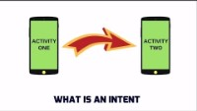
Intent

Slide 17
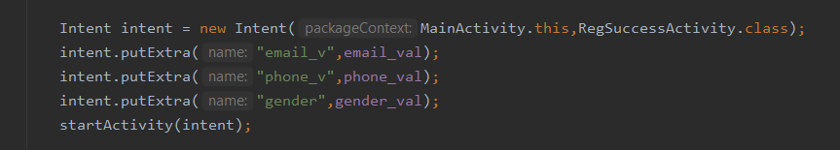
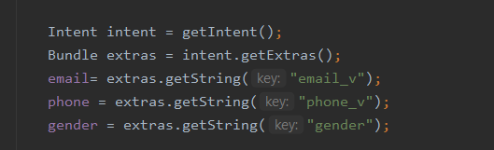
Intent (Explicit)
Explicit Intent uses function putExtra(String name, int/boolean/String var) to transfer information to new Activity.
To collect Intent information ,we collect Bundle object from receiving intent and use getExtra(String name).

Slide 18
Thank you

